Slide 1
File delete
One of the important CRUD operation is DELETE (CRUD).
The file delete operation is used to delete a specific file.
delete() method is used to delete a file in java.
This method can also be used to delete a folder/ directory as well, although that folder should be empty.

Slide 2
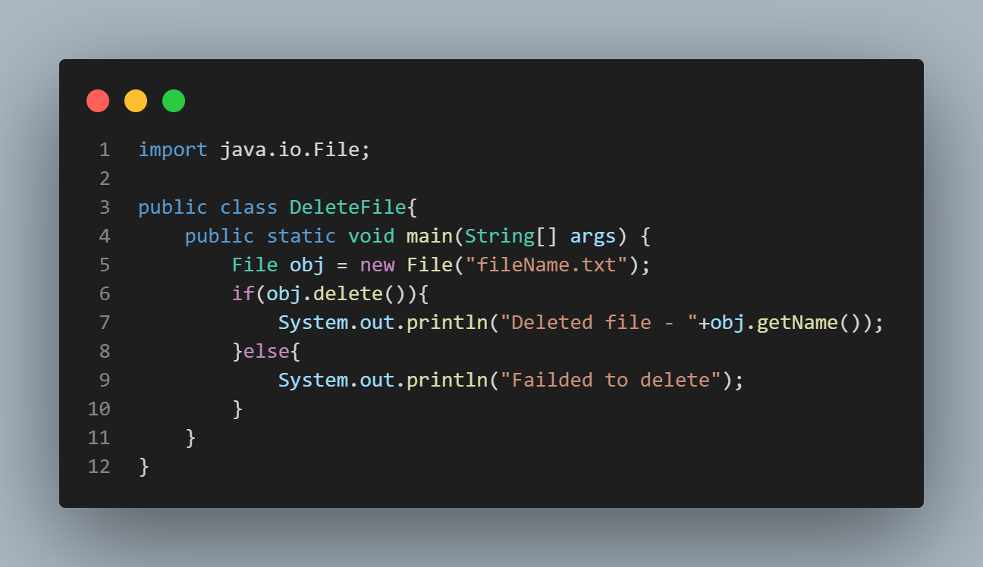

Slide 3
Various useful file handling methods in java.
canRead() - This method checks if a file is readable or not and return a Boolean result
canWrite() - This method checks if a file is writable or not and returns true or false.
exists() - This method checks if a file exist or not.
getName() - This method returns the name of the file as a String.
length() - This method returns the length of the file in bytes.
list() - This method returns an array of the files in the directory(folder).
mkdir() - This method creates a new directory.

Slide 4
